Slide 1
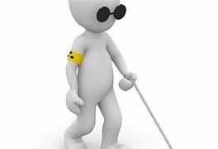
BLIND STICK USING
ULTRASONIC sensor

Slide 2
COMPONENTS REQUIRED:
1. Arduino UNO Board
2. HC-SR04 Ultrasonic Sensor
3. Buzzer
4. 9 Volt Battery
5. Switch (Optional)

Slide 3
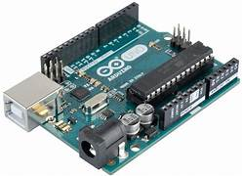
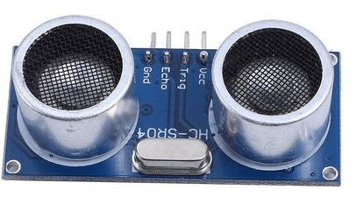
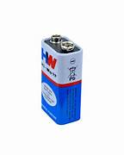
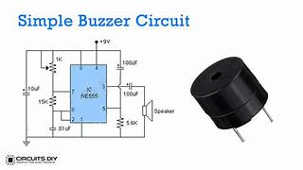
Arduino boards are able to read inputs - light on a sensor, a finger on a
button, or a Twitter message - and turn it into an output - activating a
motor, turning on an LED, publishing something online. You can tell your board what to do by sending a set of instructions to the microcontroller on the board.
Ultrasonic sensors are electronic devices that calculate the target’s distance by emission of ultrasonic sound waves and convert those waves into electrical signals. The speed of emitted ultrasonic waves traveling speed is faster than the audible sound.
A battery is a "battery" of cells, i.e. more than one cell. A 9V battery contains six 1.5V cells.
The buzzer is a sounding device that can convert audio signals into sound signals. It is usually powered by DC voltage. It is widely used in alarms, computers, printers and other electronic products as sound devices. It is mainly divided into piezoelectric buzzer and electromagnetic buzzer, represented by the letter "H" or "HA" in the circuit.

Slide 4
Blind Walking Stick Using Arduino & Ultrasonic Sensor HC-SR04
In this project, we will learn how to design Blind Walking Stick Using Arduino & Ultrasonic Sensor HC-SR04. Almost 30 million people are blind according to the recent WHO Report. These blind people are totally dependent on others as they can’t walk alone. This is the reason why we have designed the Blind Walking Stick device which will help blind people to walk with ease independently.

Slide 5
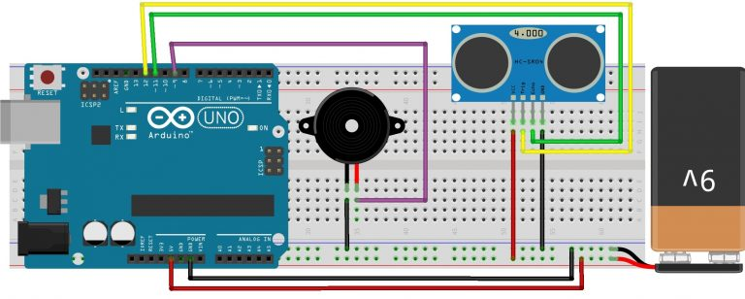
Circuit: Blind Walking Stick Arduino Ultrasonic Sensor
To design Blind Walking Stick Using Arduino & Ultrasonic Sensor HC-SR04, make the following connections as shown in the connection diagram below.

Slide 6
Vcc pin of HC-SR04 is connected to 5-volt pin of Arduino
Trigger pin of HC-SR04 is connected to D12 pin of Arduino
Echo pin of HC-SR04 is connected to the D11 pin of Arduino
The ground of HC-SR04 is connected to the GND pin of Arduino.
The positive terminal of the 9-volt battery is connected to the Vin pin of Arduino and the negative terminal is connected to the GND pin of Arduino.
A buzzer is connected between the D9 pin of Arduino and the GND pin.

Slide 7
Circuit & Working:
The main objective of this project is to help blind people to walk with ease and to be warned whenever their walking path is obstructed by obstacles. As a warning signal via buzzer, whose frequency of beep changes according to the distance of the object. The closer the distance of obstruction, the more will be the buzzer beep frequency.
The main component used for this device is the Ultrasonic Sensor HC-SR04. The ultrasonic sensor transmits a high frequency sound pulse and then calculates the time to receive the signal of the sound echo to reflect back. HC-SR04 has a transmitter & receiver surface. One of them acts as the transmitter and transmits the ultrasonic waves. The other one acts as a receiver and receives the echoed sound signal. The sensor is calibrated according to the speed of the sound in air. The speed of sound is 341 meters per second in the air, and the distance between the sensor and object is equal to time multiplied by the speed of sound divided by two.

Slide 8
*Distance = (Time * Speed Of Sound) ÷ 2
After the distance measurement, Arduino makes a beep format using a buzzer, when the distance is high, the frequency of beep is decreased and beep frequency is increased when the distance is low.

Slide 9
Source Code :
int buzzer = 9;
#include <Ultrasonic.h>
Ultrasonic ultrasonic(12,11);
void setup() {
Serial.begin(9600);
pinMode(buzzer,OUTPUT);
}
void loop()
{
int distance = ultrasonic.Ranging(CM);
if (distance<50){
int dil = 2*distance;
digitalWrite(buzzer,HIGH);
delay(dil);
digitalWrite(buzzer,LOW);
delay(dil);
}
}

Slide 10
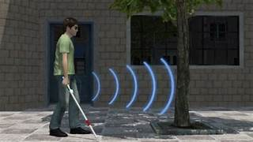
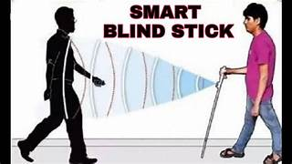

Slide 11
CONCLUSION:
The Blind Walking Stick has been at last made into a model which can be utilized to direct the visually impaired. It intends to tackle the issues looked at by visually impaired individuals in their everyday life. The framework likewise takes the action to guarantee their security. This undertaking will work to help every one of the visually impaired individuals on the planet to make them simpler to walk wherever they need. It was done to assist the visually impaired with moving in front quite well. It is utilized to assist individuals with handicaps that are heedless to work with the development and increment security

Slide 12
THANK YOU

